Slide 1
Unwrapping Valentine's Day:
A Data-Driven Look into Love & Spending
By Team HeartCode ❤️ (Group 11) | April 2025

Slide 2
GROUP MEMBERS
Adrian Kiprop
Richard Otolo
Joy Thiong’o
Lauryn Kemunto
Maureen Imanene

Slide 3
Business Question
How do age and gender influence spending patterns on Valentine's Day gift categories over time?
Why this matters:
Helps brands personalize campaigns
Reveals shifting consumer behavior over time

Slide 4
Data Sources
historical_spending.csv: Yearly spend by category (2010–2022)
gifts_gender.csv: Spend distribution by gender
gifts_age.csv: Spend distribution by age group

Slide 5
Methodology
Data Cleaning & Reshaping: Unpivoted category columns
Dimensional Model: YearTable, CategoryTable, GenderTable, AgeGroupTable
Tools: Power BI, DAX, Power Query
Key Metrics: Total Spend, YoY Growth %, Category Breakdown

Slide 6
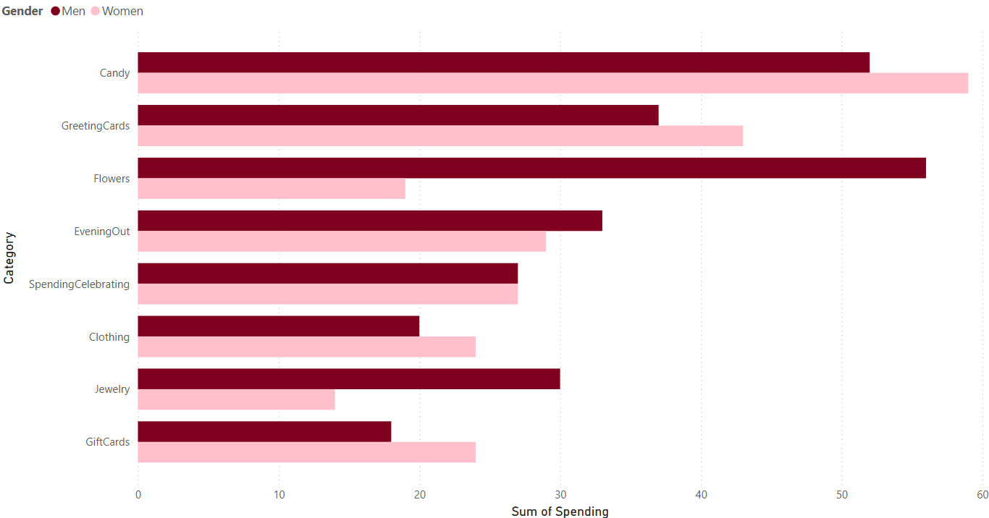
Spending Trends Over Time

Slide 7
Insights
• Jewelry and Flowers lead in total spend
• Gift Cards and Experiences are rising
➡️ Opportunity to promote digital and experiential gifts

Slide 8
Insights on Gender-Based Spending
• Women spend more on Jewelry and Cards
• Men lean toward Evenings Out and Candy
➡️ Tailor campaigns based on gender preferences

Slide 9
Insights on Age Group Preferences
• Young adults favor experiences and flexible gifting
• Older demographics lean traditional (e.g., flowers, jewelry)
➡️ Age segmentation can drive targeted promotions

Slide 10
Insight on Top 3 Categories by YoY Growth
• Gift Cards and Evenings Out show highest growth
➡️ Trend signals preference for flexibility and experience-based gifts

Slide 11
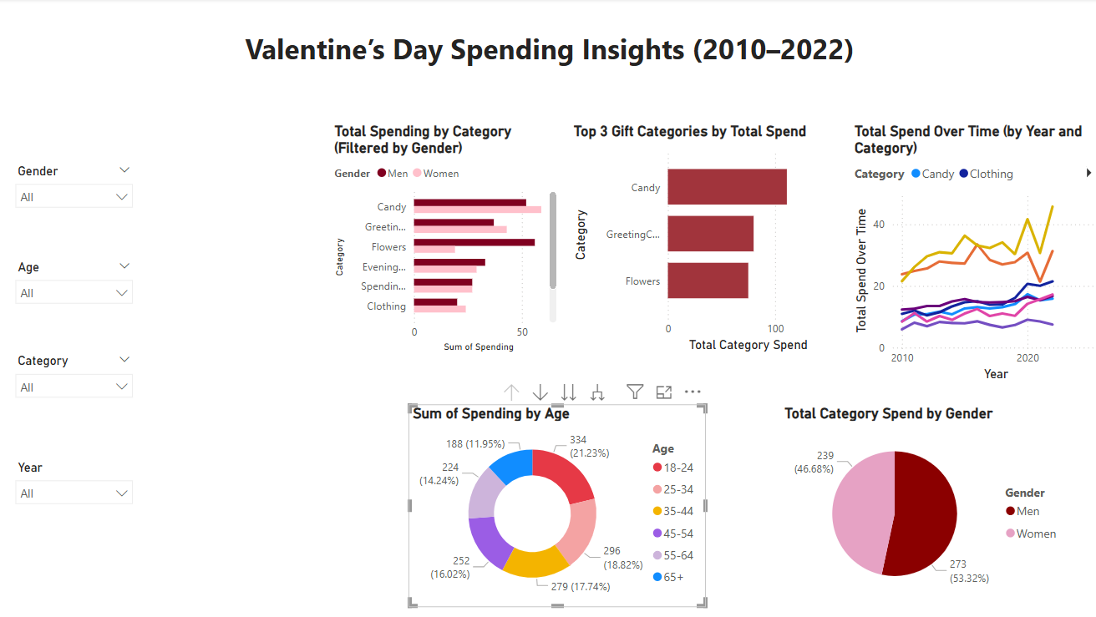
Dashboard Walkthrough

Slide 12
Gaps & Opportunities
Limitations:
No location or sentiment data
Binary gender data only
In Future we can:
Integrate Google Trends / social sentiment
Expand to geo-based insights

Slide 13
Conclusion
🎯 Valentine spending is shaped by age and gender
📈 Experiences and gift cards are rising in popularity
📣 Businesses can leverage these insights for smarter, targeted campaigns

Slide 14
Thank You / Q&A
Thank you! We’d love to hear your questions or thoughts.
Team HeartCode ❤️

